Slide 1

How to Use REDCap for Your Research Project
Carsten Skarke, MD
Credit: Mehau Kulyk/SPL/Getty https://www.nature.com/articles/d41586-018-05990-5

Slide 2
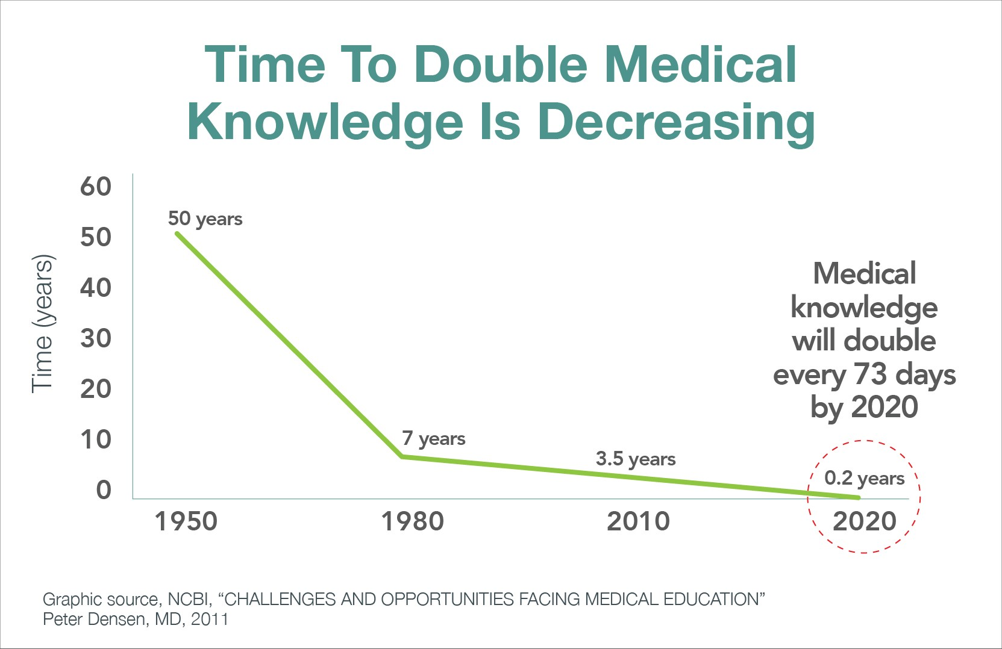
Drowning in data
Densen P Trans Am Clin Climatol Assoc. 2011 PMID: 21686208
Notes:
https://econvue.com/pulse/goodbye-%E2%80%9Cdr-know-it-all%E2%80%9D-medicine%E2%80%99s-liberating-knowledge-explosion

Slide 3

Your Data – Your Responsibility
40% retractions due to “errors, problems with reproducibility, and other issues”
60% retractions due to “fraud or other kinds of misconduct”
Jeffrey Brainard & Jia You. Science 2018
Notes:
https://www.sciencemag.org/news/2018/10/what-massive-database-retracted-papers-reveals-about-science-publishing-s-death-penalty#sidebar2

Slide 4

REDCap is a secure web application for building and managing online surveys and databases. While REDCap can be used to collect virtually any type of data in HIPAA-compliant environments, it is specifically geared to support data capture for research studies.

Slide 5
Research protocol flow chart

Slide 6
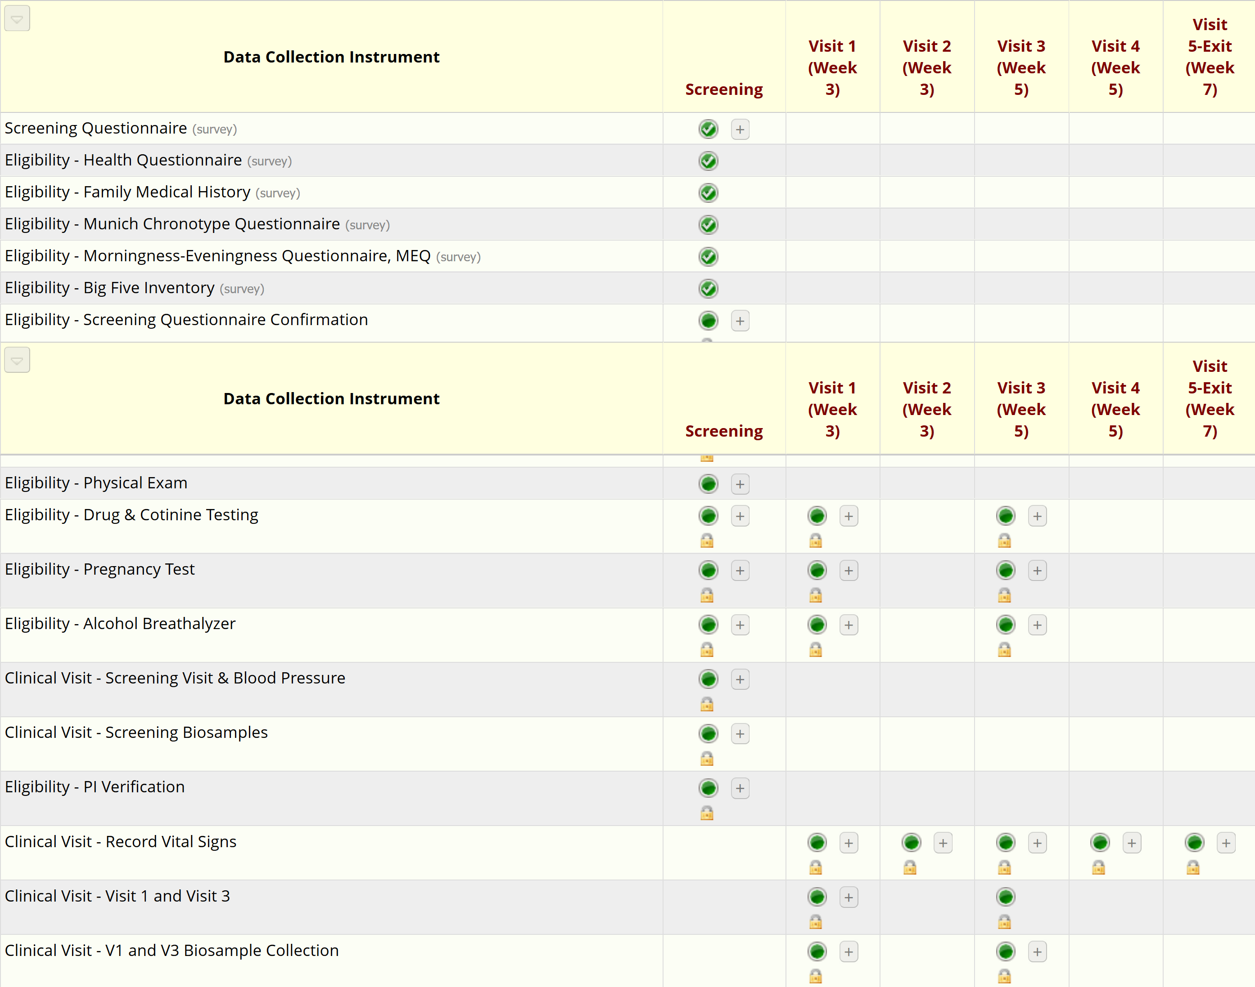
Translated into REDCap project

Slide 7
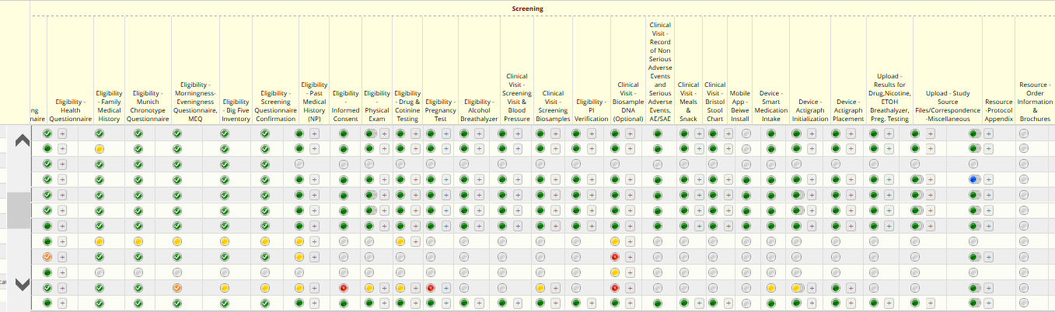
Study progress

Slide 8
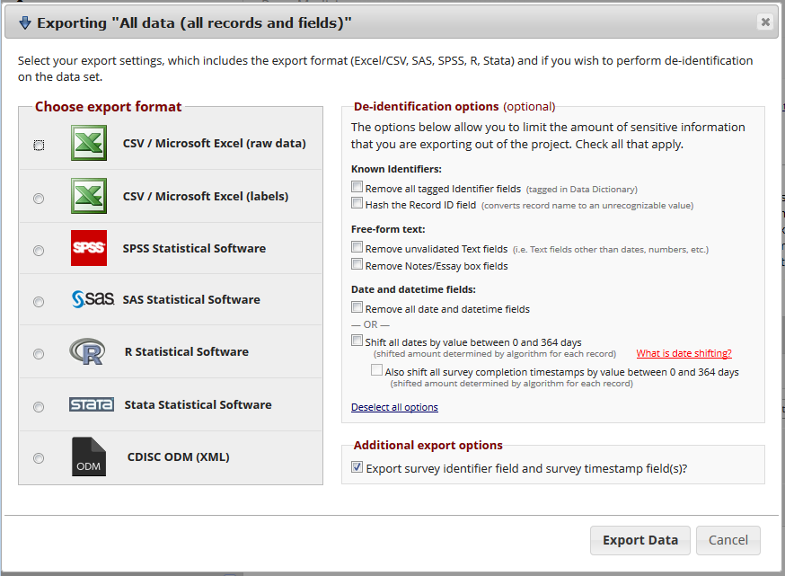
Data Export Options

Slide 9
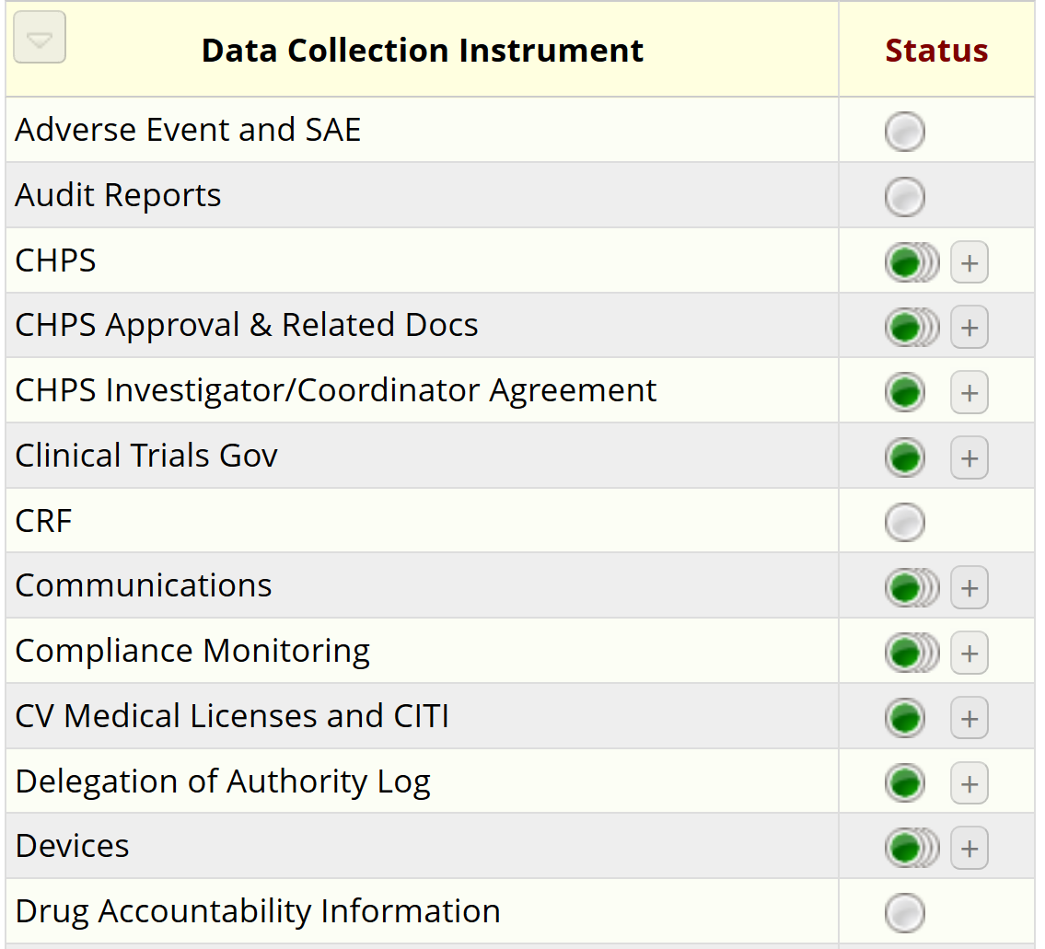
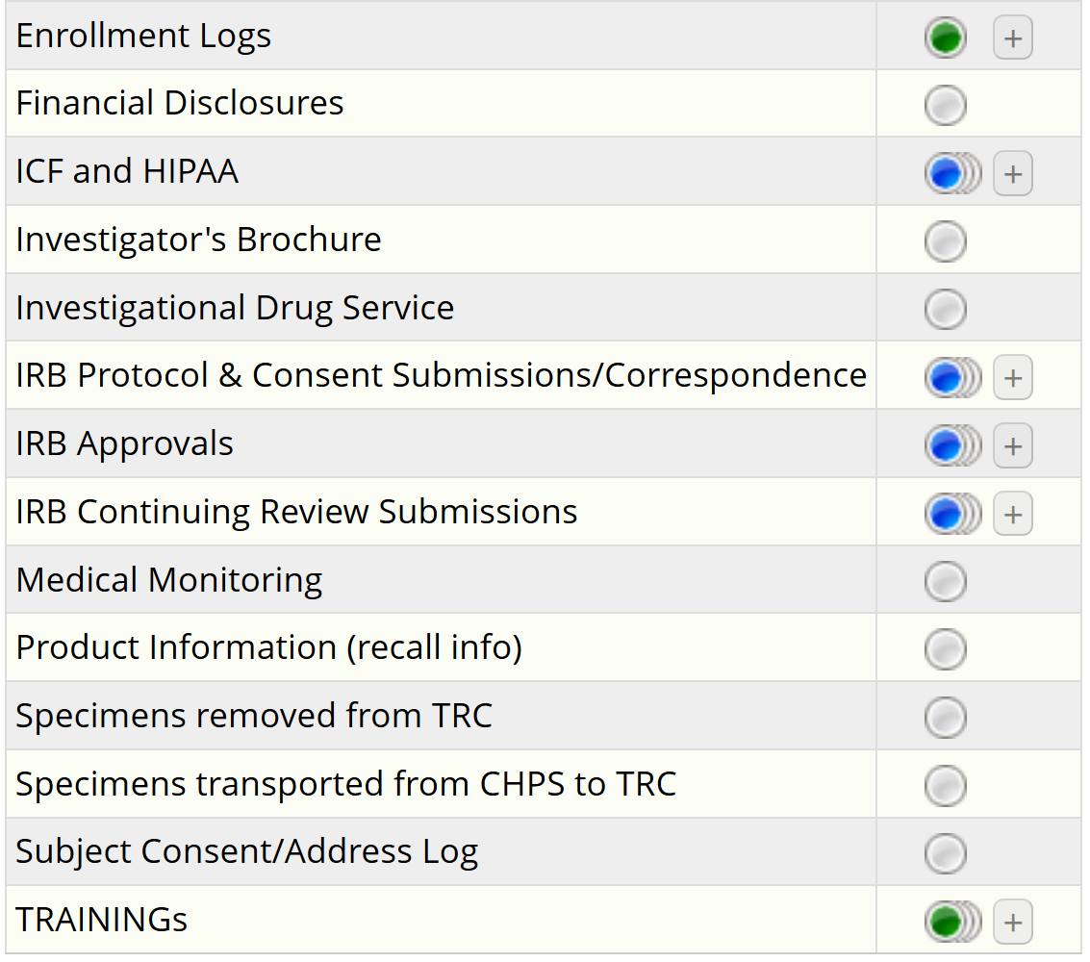
Organize your regulatory science

Slide 10
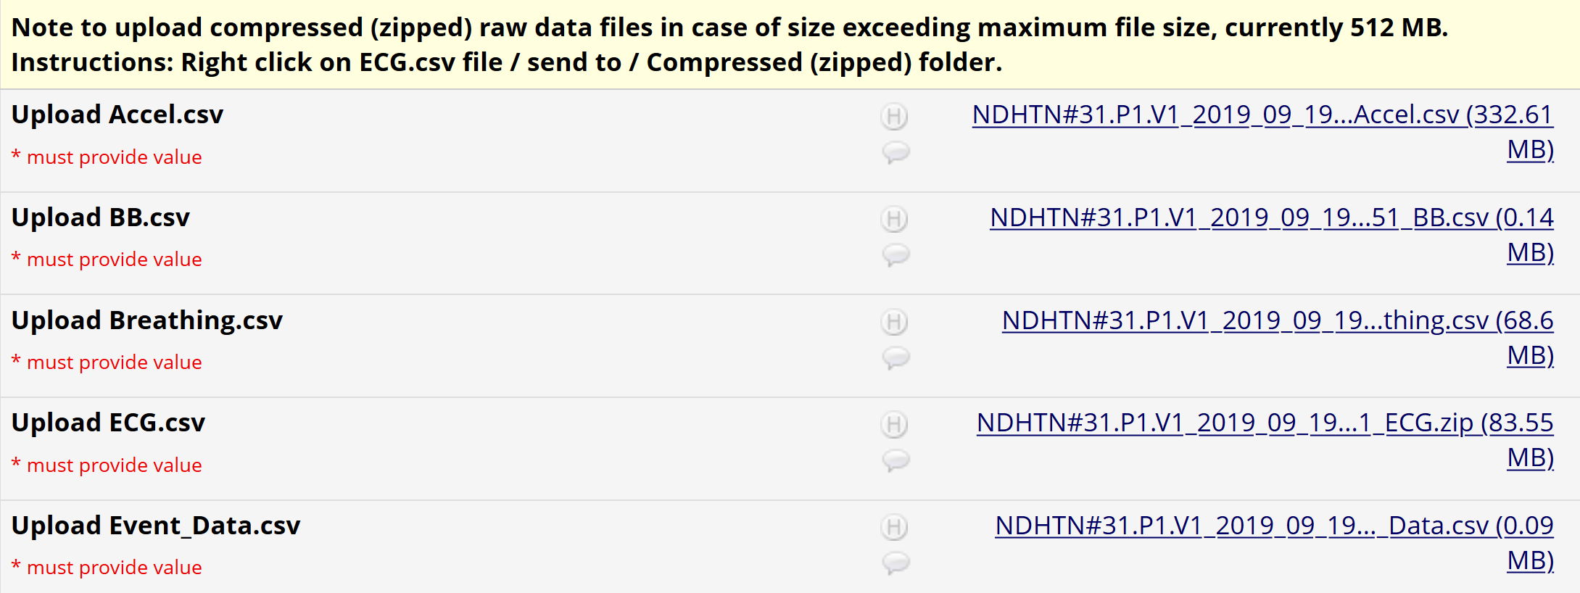
Secure your data
pristine
ECG.csv = 22,336,250 data rows
Excel maximum row number = 1,048,576 data rows
Notes:
1,048,576 = 20 bits = 2 to the 20th power

Slide 11
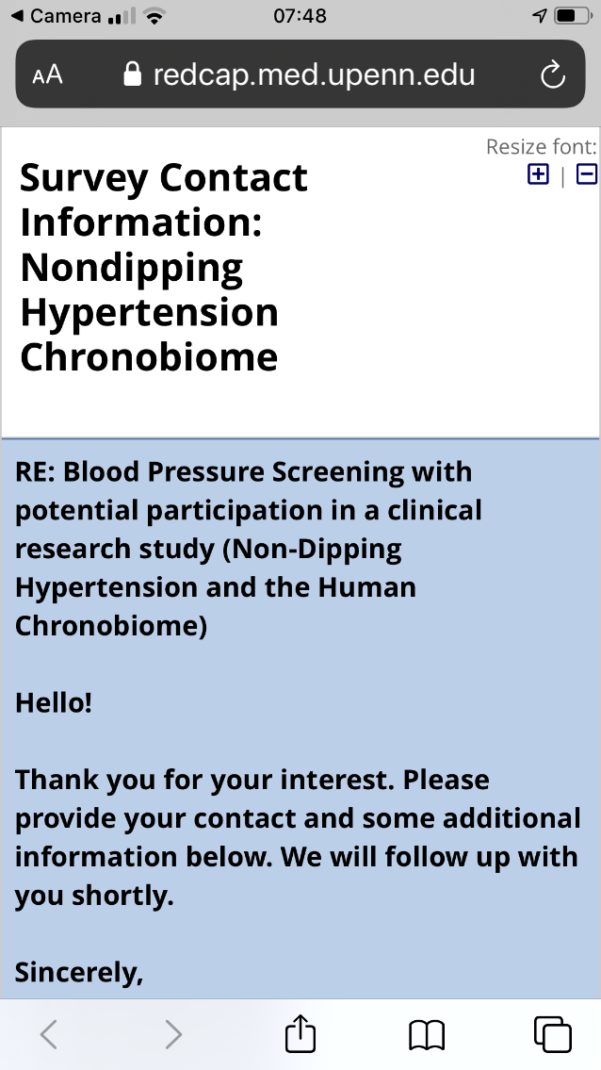
Find your study participants

Slide 12
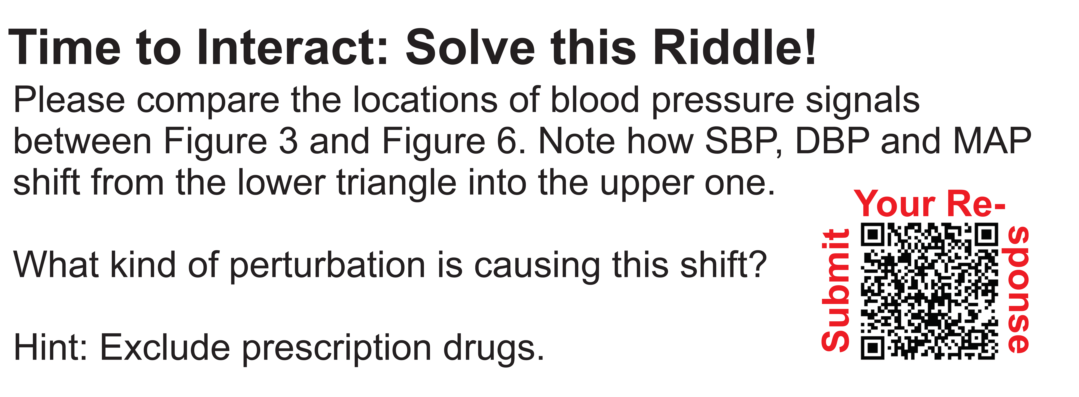
Promote your research

Slide 13
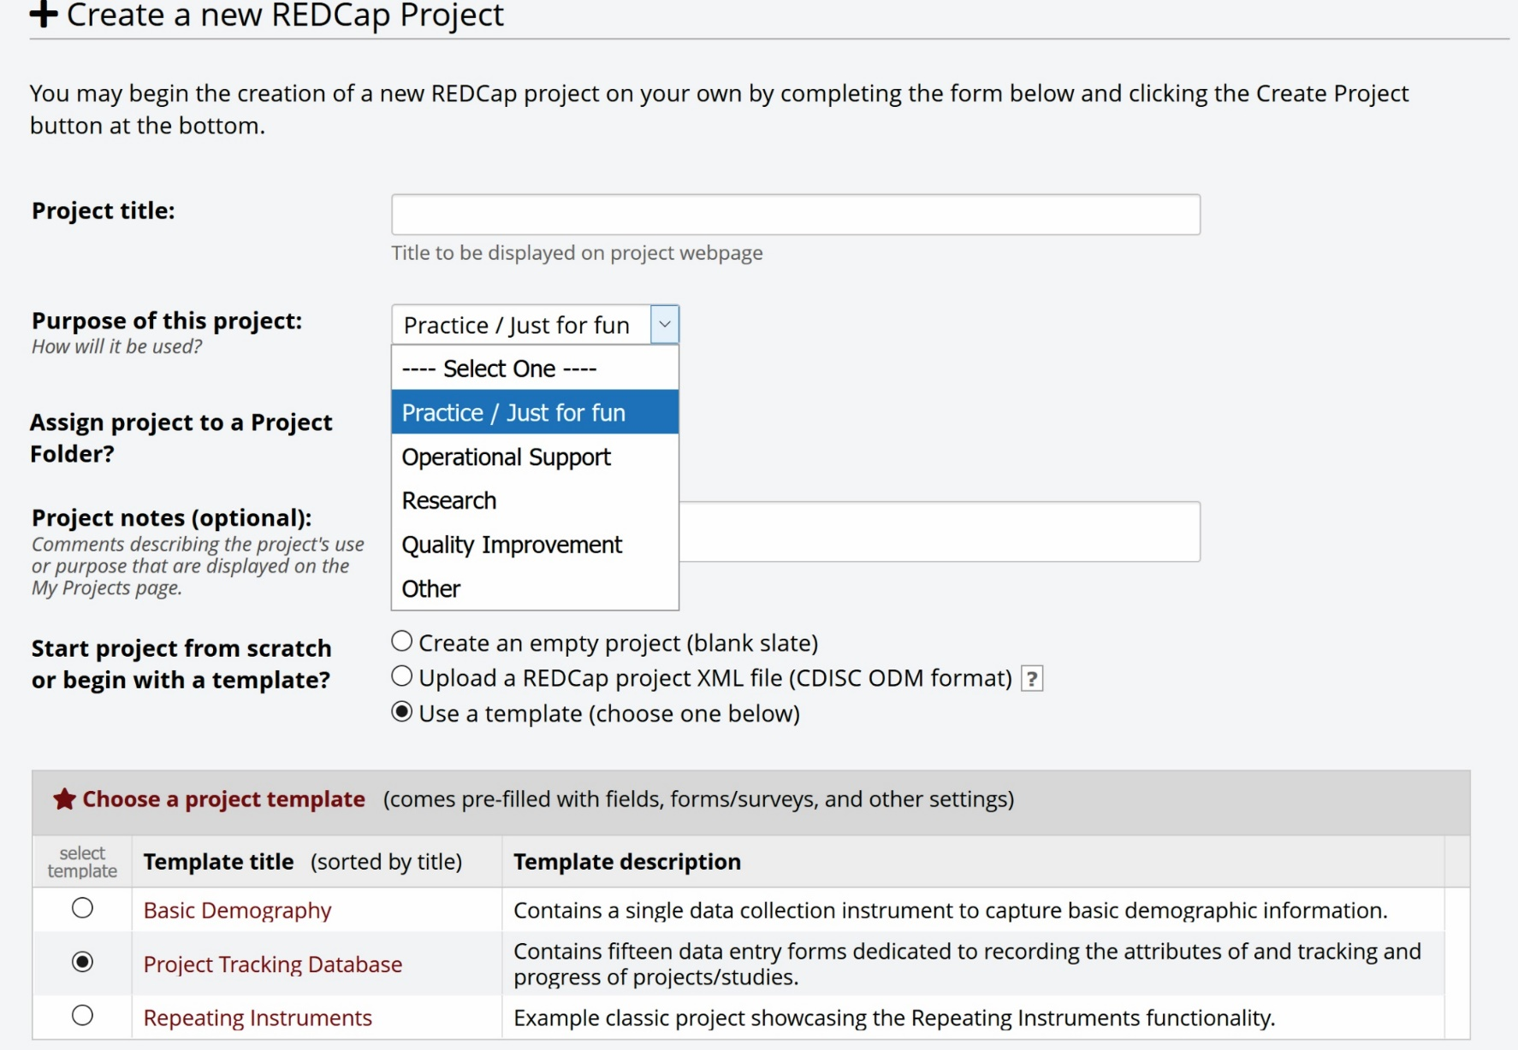
Learn the mechanics of REDCap

Slide 14
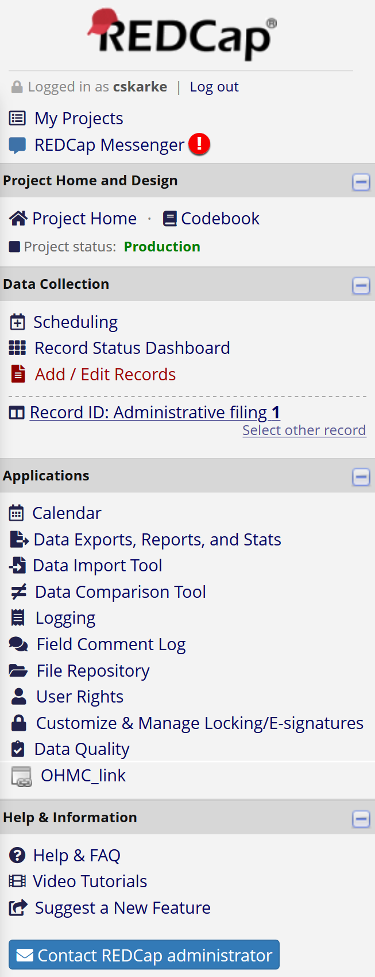
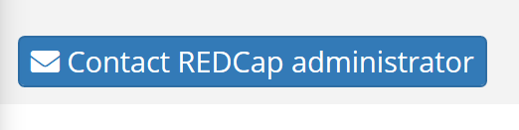
Support at Penn

Slide 15
Dive deeper:
REDCap Training
Ros McNeill
Office of Clinical Research (OCR)
Sr. Training Specialist
rmcneill@upenn.edu
Shawn Ballard
Clinical Research Computing Unit (CRCU)
Technical Director, Software Systems
sballard@pennmedicine.upenn.edu

